Slide 1
BHAGWANT UNIVERSITY
Sikar Road, Ajmer (Rajasthan)
Department of Civil Engineering
Progress Report
From Nov 2016 To Jan 2017
WELCOMES YOU

Slide 2
AGENDA
Vision And Mission of The Department
Faculties in Civil Engineering Department.
Students Strength at a Glance.
Performance Report of 2016-17
Departmental Activities & Achievements.
Student Activities and Achievements.
Future Plans – Placement Assistance.

Slide 3
VISION AND MISSION OF THE DEPARTMENT
VISION:
“The Civil Engineering Department strives to be recognized globally for outstanding education, research and develop self confidence in studies to take any type of job and practical”.
MISSION:
Imparting quality education to the students and enhancing their skills to make them globally competitive civil engineers.
To develop linkages with world class construction organizations and educational institutions in India and abroad for excellence in teaching, research and consultancy practices.

Slide 4
FACULTY MEMBERS
ER. AMIT CHOUDHARY (H.O.D.)
ER. T.N. PANDEY (ASSISTANT PROFESSOR)
ER. JITENDRA SINGH (ASSISTANT PROFESSOR)
ER. BHARAT PHULWARI (ASSISTANT PROFESSOR)
ER. UTSAV SHARMA (ASSISTANT PROFESSOR)
ER. RAM GODARA (ASSISTANT PROFESSOR)
MR. JAINARAYAN NAHAR (LAB. TECH.)
MR. GULZAR AHMAD DAR (LAB. TECH.)

Slide 5
STUDENT STRENGTH OF DEPARTMENT
The total strength of students in the department are 431.
M.Tech Civil have 23 students.
B.Tech Civil have 222 students.
Diploma Civil have 186 students.

Slide 6
Performance Report of odd Semester 2016-17
S.No. | Course | Branch | Sem | Total no of students | Pass | Fail | Pass percentage
1 | DIPLOMA | CE | I | 68 | 68 | 0 | 100
2 | DIPLOMA | CE | II | 84 | 84 | 0 | 100
3 | DIPLOMA | CE | III | 90 | 90 | 0 | 100
4 | B.TECH | CE | III | 39 | 32 | 07 | 90
5 | B.TECH | CE | V | 68 | 63 | 05 | 92
6 | B.TECH | CE | VII | 83 | 83 | 0 | 100
7 | M.TECH | CONST.ENGG | I | 02 | 02 | 0 | 100

Slide 7
Performance Report of odd Semester 2016-17
S.No | Course | Branch | Sem | Total no of students | Pass | Fail | Pass percentage
8 | M.TECH | CONST.ENGG | I | 01 | 01 | 0 | 100
9 | M.TECH | ENV.ENGG | I | 01 | 01 | 0 | 100
10 | M.TECH | STR.ENGG. | I | 01 | 01 | 0 | 100
11 | M.TECH | TRANS.ENGG. | III | 12 | 12 | 0 | 100
12 | M.TECH | CONST.ENGG | III | 01 | 01 | 0 | 100
13 | M.TECH | ENV.ENGG | III | 01 | 01 | 0 | 100

Slide 8
DEPARTMENTAL ACTIVITIES
On 07.02.2017 organized 1 Day seminar on Construction Tips of Civil Engineering, Presented By Ultra Tech Cement Ajmer.
On 18.10.2016 organized 1 Day seminar on “Swadesi Apnao Desh Bachao”.

Slide 9
On 17.11.2016 organized 1 Day seminar on 2-D and 3-D designing software's by Cadd Centre, Ajmer.
From 24.10.2016 to 29.10.2016 organized 5 days Industrial Tour at Chandigarh & Shimla.
On 24.10.2016 organized Sport Week 2016 & Inter State College Tournament.

Slide 10
ACTIVITIES CONT …
From 03.10.2016 – 09.10.2016 organized Tech Fest 2016 & Participated all final year students.
On 15.09.2016 Engineer’s day celebrated at campus also University participated at cultural program of AEI(Ajmer Engineer’s Institution, Ajmer).
On 02.09.2016 organized 1 Day Industrial visit in Parle-G Production Factory & Participated all Final & Pre-final year students.

Slide 11
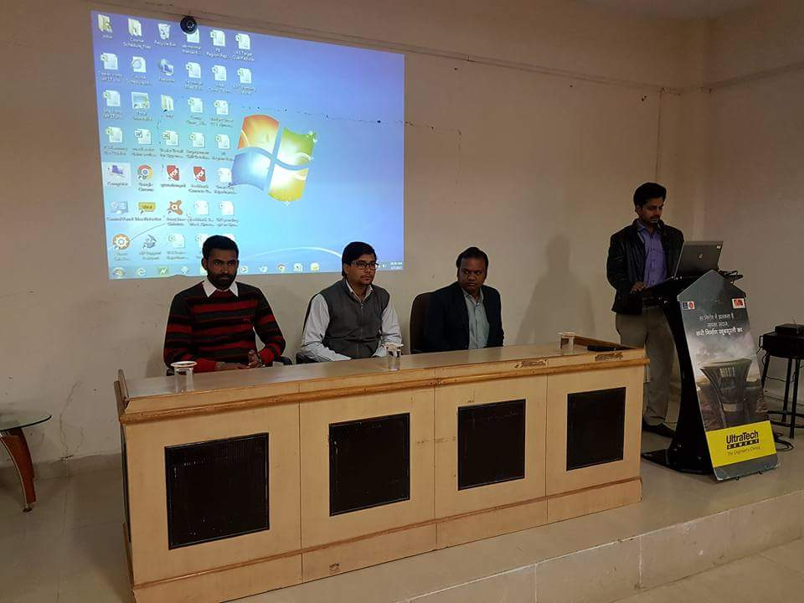
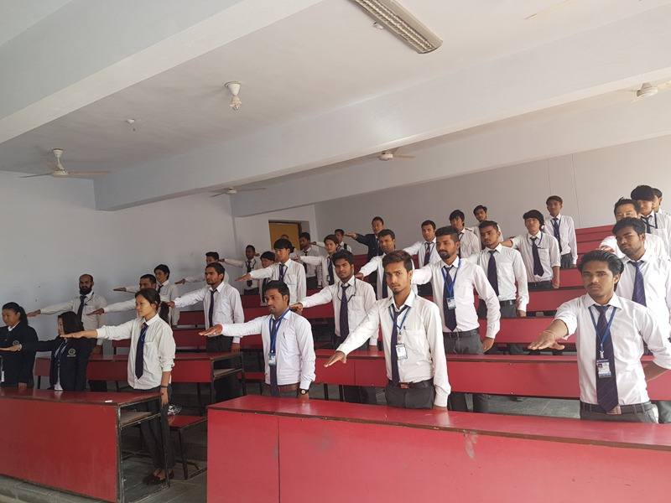
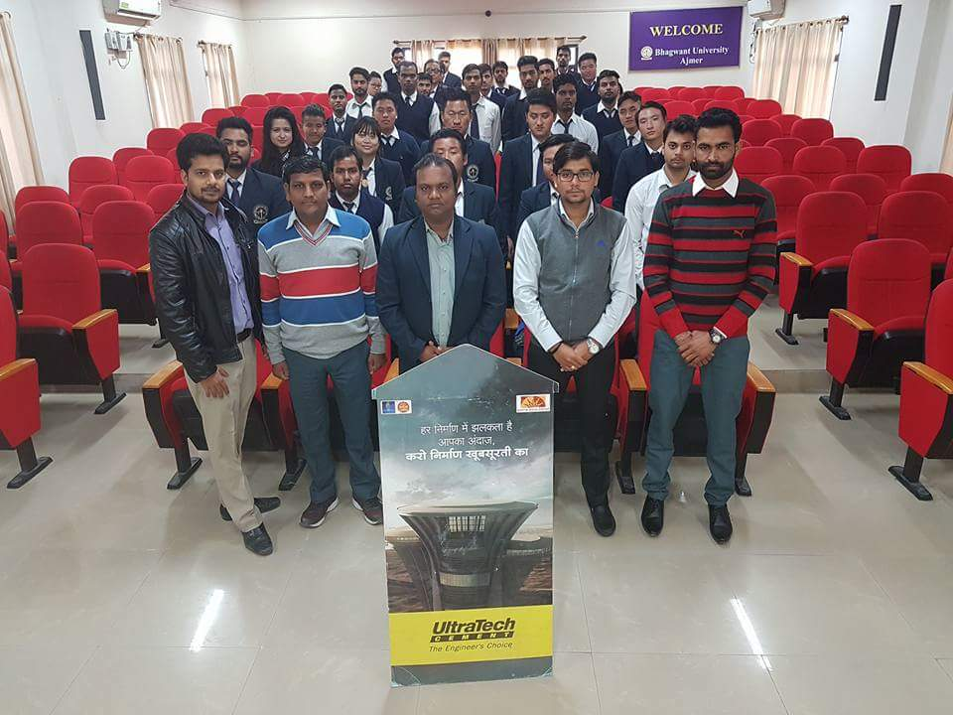
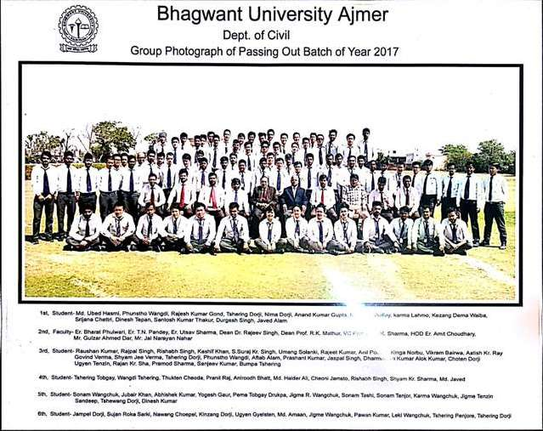
ACTIVITIES AT A GLANCE

Slide 12
STUDENT RESULTS & ACHIEVEMENTS
The result of last passed out final year students was Excellent.
Total Pass percentage : 100 %.
In the session 2015-16, Plenty of students placed in various companies.
Four students ( Videsh Mathur, Saurabh Mathur, Shrijana Chhetri, Neelam Ghalley) ,visited to Singapore on 17th Nov 2016.

Slide 13
DEPARTMENTAL ACHIEVEMENT
On Sept. 5th occasion of Teachers day celebrated.
On Sept. 15th occasion of Engineer’s day celebrated.
Celebrated all Civil Faculties Birthday.
Proposal for Established Geology Lab. In the department.

Slide 14
HIGHER EDUCATION/MEMBERSHIP IN DEPARTMENT
Er. T.N. Pandey Completed his M.Tech (Env.Engg.)
Er.Bharat Phulwari Completed his M.Tech (Cons.Engg.)
Er.Jitendra Singh Completed his M.Tech (Cons.Engg.)
Faculties Published National and International Papers.

Slide 15
Future Plans – Placement Assistance
To give more emphasis on Entrepreneurship , selecting the projects in such an orientation and helping the students to start up their own ventures.
Giving awareness to our final year students about
“Entrepreneurship Awareness Camp” program – which is platform for young engineers to convert their ideas into prototype and later into products.

Slide 16
Thank You ????

