Slide 1
Kick
Submited to :- Submitted by:-
Er Akash Rana Devahish Yadav
B.Tech IIIrd Year
Petroleum Technology

Slide 2
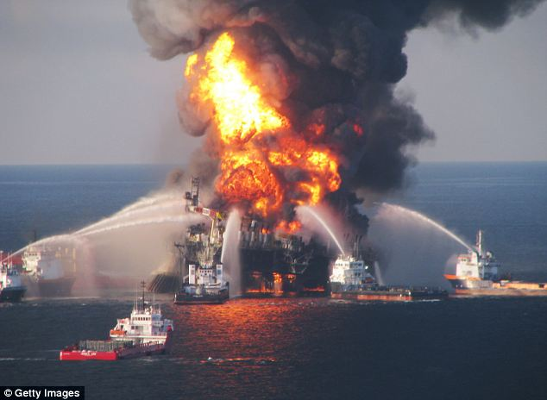

Slide 3
contents
1. introduction of kick
2. causes of kick
3. Indicate of kick
a. mud pit level/flow increase
b. incorrect fill up during trips.
c. Increase pump rate
d. decrease drill string weight
4.Control of kick

Slide 4
“Kicks”
• A kick is the term used to describe the inflow of formation
fluid into the wellbore during drilling operation.
• This arises due to the formation pressure being greater
than the hydrostatic pressure imposed by the mud column.
• This can happen in a normal or abnormally pressured
formations.
• A kick may be primarily composed of salt water, oil, natural
gas or a combination of the fluids. The influx of formation
fluid may arise for a variety of reason.

Slide 5
Causes of Kicks
• Insufficient mud weight;
• Swabbing;
• Not keeping the hole full;
• Loss of circulation (partial and full);
Kicks occurring during drilling operations most often
occur due to insufficient mud weight.
Kicks generally occur during trips with the influx occurring
from a combination of swabbing and failure to keep the hole
full. Swabbing is the result of the piston effect of the drillpipe
due to excessive trip speed resulting in instantaneous vacuum
being created below the bit

Slide 6
Maximum Working Casing Pressure
• The casing and blowout preventer (BOP)
are designed for the different expected
pressures during each drilling phase.
• This is determined during well planning.
• The pressure requirements are based on
the maximum anticipated pressures
caused by a gas kick.

Slide 7
Kick Indicators
1. Mud Pit Level / Flow Increase
These parameters are major positive indicators. As
the influx of formation fluid displaces the mud in the
annulus, the pit level would increase in the active mud
tanks. There would also be evidence of increase in
return flow rate if logged. The effectiveness of pit
gain/flow increase depends on:
• Initial size and type of kick;
• Mud fluid base and rheology;
• Minimum sensitivity of the measuring systems

Slide 8
2. Incorrect Fill-up During Trips
• If the hole does not take the correct volume of
mud for the volume of pipe pulled from the hole
then an influx has probably been swabbed into
the well bore
• The driller and mud loggers should be
maintaining independent records of volume taken
to fill the hole for every 5 stands
• If the hole fill is not correct go back to bottom
and circulate bottoms up to check what is at the
bottom of the hole

Slide 9
3.Decrease in Standpipe Pressure/Increase in Pump Rate
The circulation system is a U-tube. An influx of
fluid into the annulus creates an imbalance
resulting in a decrease in hydrostatic pressure in
the annulus. In such an unbalanced system,
gravity helps move drilling fluid down the hole,
requiring less energy from the pump. This will
result in a decrease in the standpipe pressure

Slide 10
4. Increase/Decrease in Drillstring Weight
Any influx into the wellbore from the formation
reduces the buoyancy of the annular drilling fluid.
A sensitive weight indicator will register this
change in weight as an increase in drill string
weight.
For very large kicks, fluid may enter the annulus
with enough force to cause a decrease in
indicated string weight.

Slide 11
Formulas Used in Kick and Kill Procedures
1) Hydrostatic Pressure (psi)= MW x TVD x 0.052
where: MW = Mud Density (lb/gal)
TVD = True Vertical Depth (ft)
2) Circulating Pressure (psi)= (MW x TVD x 0.052) + Pla
where: Pla = Annular Pressure Loss (psi)
3) Initial Circulating Pressure (psi)= SPR + SIDP
where: SPR = System pressure loss at kill rate (psi)
SIDP= Shut-in Drillpipe Pressure (psi)
4) Final Circulating Pressure (psi)= (KMW / MW) x SPR
where: KMW = Kill Mud Density (lb/gal)
5) Kill Mud Weight (lb/gal)= MW + (SIDP / (TVD x 0.052))

Slide 12
6) Formation Pressure (psi)= SIDP + (MW x TVD x 0.052)
7) Density of influx (ppg)= MW - [(SICP - SIDP)/(L x 0.052)]
where: SICP= Shut in casing pressure (psi)
L = Length of influx (ft)
8) Length of kick around drill collars (ft)=
Pit Gain (bbls)/ Annular Volume around collars (bbls/ft)
9) Length of kick, drill collars and drill pipe (ft)=
Collar Length + [(Pit Gain - Collar Annular Volume) / (D₁² - D₂² x 0.000971)]
where: D₁ = hole diameter (inches)
D₂ = drillpipe diameter (inches)
10) Gas bubble migration rate (psi/hr)= Pa / (0.052 x MW)
where: Pa = pressure change over time interval / time interval (hr)

Slide 13
Normal Procedure followed when a Kick is Encountered
1) Pick up the kelly and note the position of tool joints in relation to the drilling spools.
2) Stop the pumps.
3) Open the choke line.
4) Close the annular preventer or ram preventers.
5) Close the choke.
6) Record the pit gain.

Slide 14
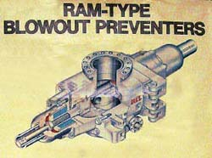
type of bop
1. Ram type bop

Slide 15
Ram Preventers
• Pipe rams- have a rubber face moulded to fit around a
certain size of drillpipe. If more than one size drillpipe is in
use, there must be one set of pipe rams for each size of
pipe.
• Blind rams- completely close off the borehole. As such,
they are used only when there is no drillpipe in the
borehole;
• Shear rams- have specially designed cutting structures,
which when closed on drillpipe, will cut through the
drillpipe and completely close off the borehole.
• In an emergency, the ram preventers may be manually
closed (but only on land rigs and jack-ups).

Slide 16
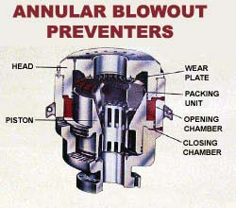
Annular bop

Slide 17
Annular BOP
-Annular bop are designed to form a seal in the annular space between the drill pipe and the wellbore are usually mounted at the top of the bop stack.
-Consist of an annular rubber sealing element when
Pressure is applied close around the drill pipe or killy.
-Pressur can be applied progresively the annular
Preventer can be made to close on the any size or type.
-A slight relaxation of pressure may allow a small leakage
Of fluid. Permite the pipe to be rotate within the annular preveter pulled through slowly.

Slide 18
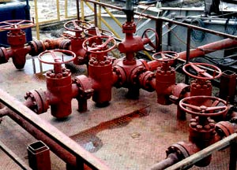
Choke manifold

Slide 19
Choke manifold
A choke manifold is a system of valves used to circulate out a kick and circulate mud of proper weight. This device responds automatically to a kick and can prevent a blowout if properly installed and maintained.

Slide 20
Choke and Kill Lines
• After the BOP is closed, high-pressure fluid can be released
at carefully controlled rates by use of a hydraulically controlled
valve (“choke valve”). The choke line carries these high
pressure fluids to the choke. From here the flow goes through
the “poor-boy” de-gasser which removes the free gas. It then
returns to the pits for treatment and further de-gassing with
the vacuum de-gasser
• The kill line is used to introduce heavy drilling fluid to the well
through a check-valve on the BOP in order to control high
formation pressures. It fills the borehole from the top (instead
of using the drillpipe to fill the borehole from the bottom). It is
also used to fill the annulus when pipe is being tripped out

Slide 21
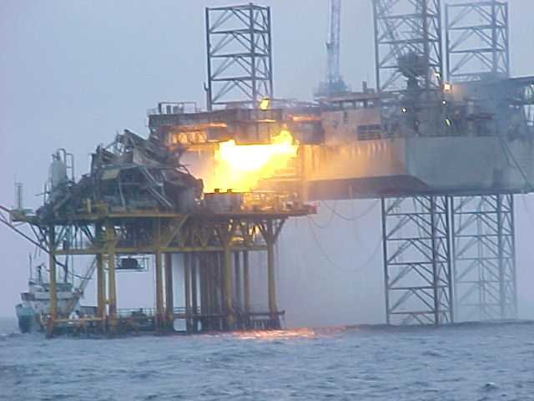
If You Get it Wrong!

Slide 22
Thank you
ANY QUERY ?

